Slide 1


Meet south Africa

Slide 2
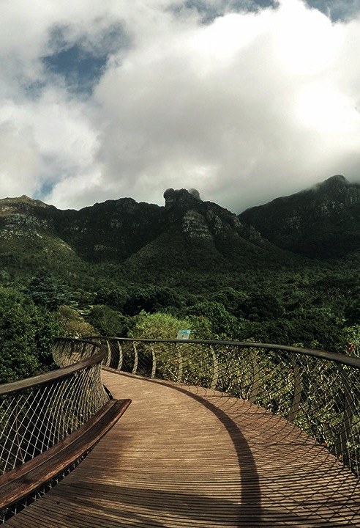
PROGRAMME
INTRO AND WELCOME.
ADDRESS BY SA Embassy
ADRESSS BY MR TOLGA GENCER ( Executive Board Member/ TÜRSAB)
ADDRESS BY MS NELISWA NKANI - HUB HEAD INDIA,MIDDLE EAST, SOUTH EAST ASIA AND TURKEY.
DESTINATION PRESENTATION BY MR SADIQ DINDAR
THE PLACE OF THE RISING SUN PRESENTATION BY MS SMA DLAMINI
EXPLORE GAUTENG PRESENTATION BY MS. MPUTLE DIKOBE
THE EASTERN CAPE IS YOURS TO EXPLORE PRESENTATION BY MS. SUSAN WILSON
TOURISM KWAZULU NATAL PRESENTATION BY MS. THABILISE MTHETHWA
QUESTION AND ANSWERS
CLOSING REMARKS AND VOTE OF THANKS

