Slide 1


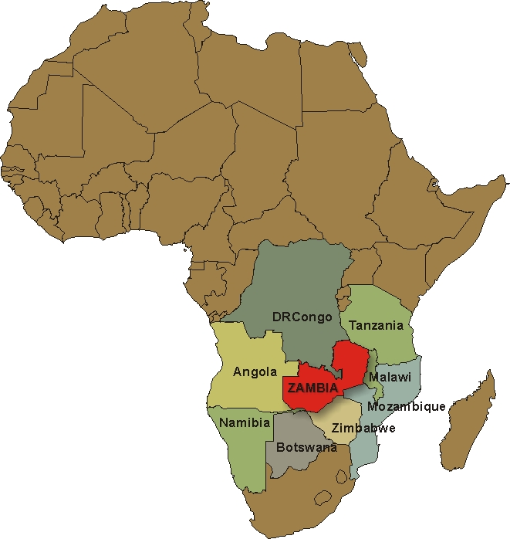
Overview: Tourism Development in Zambia
Republic of Zambia
Embassy of the Republic of Zambia
Ankara
Presented by: Bwalya Lyapa Nondo
Charge’ d’ Affaires

Slide 2
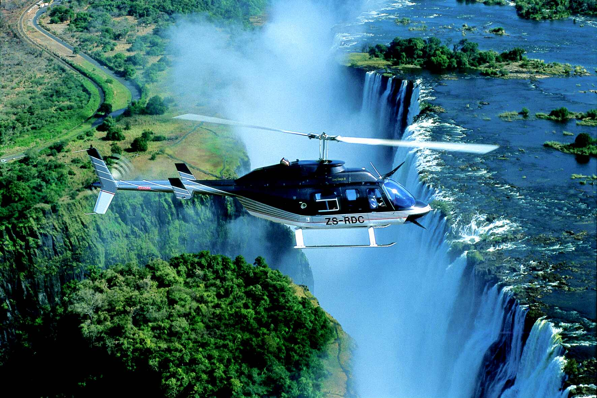
SCOPE OF PRESENTATION
Part One:
Country Profile
Government Policy on Tourism
Measures to encourage growth of tourism
Tourism Product Base
Democracy Index
Examples of Tourism Investments

Slide 3
Country Profile
Land Mass: 752,614 Square Kilometers.
Land locked but land linked & centrally located within the Southern African Region.
Neighbours: Angola, Botswana, DRC, Namibia, Malawi, Mozambique, Tanzania & Zimbabwe.
Population: 13 million.
Religion: Predominantly Christian.
Official language: English.
Ethnic Groups: 73 (All co-existing).

Slide 4
GOVERNMENT POLICY ON TOURISM
Tourism prioritized second on the economic agenda after agriculture.
Private sector driven-previously state owned enterprises have been privatized or put on long lease.
Balanced use of natural resources to ensure sustainable tourism.
Private/Public Partnerships to give impetus to the growth of the tourism sector.
Introduction of Tourism & Hospitality Act.

Slide 5
MEASURES TO ENCOURAGE GROWTH OF TOURISM
Infrastructure development in three priority areas namely Kafue National Park, Northern Circuit & the Tourist Capital, Livingstone.
Kasaba-Bay Tourism Project with more than 20 investment sites.
Rehabilitation and expansion of airports.
Rehabilitation and construction of roads leading to tourism sites.
Upgrading of power supply to all potential tourism sites.
UNIVISA

Slide 6
Tourism product base
Mainly nature-based
20 National Parks & 36 Game Management Areas.
The Victoria Falls-one of the seven wonders of the world.
Walking Safari (world’s biggest scope).
Spectacular cultural heritage.
The Kavango-Trans-Frontier Conservation Area (KAZA-TFC)-28,000 Sq Km making it the biggest Park in the world. It is a shared estate by 4 Southern Africa Development Community (SADC) member countries namely Zambia, Zimbabwe, Angola, Botswana & Namibia.

Slide 7
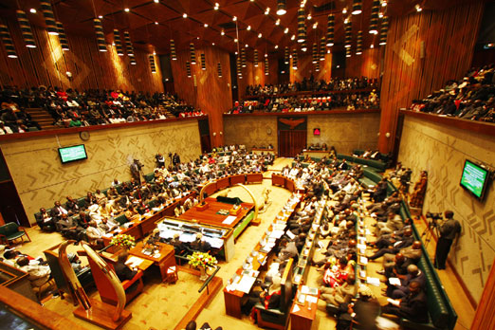
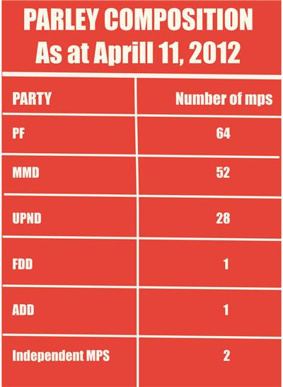

Democracy Index
Stable Political and Social Environment
EIU Democracy Index (Zambia)
71st globally
7th in Africa
Index of Africa Governance
16 Out 0f 43

Slide 8
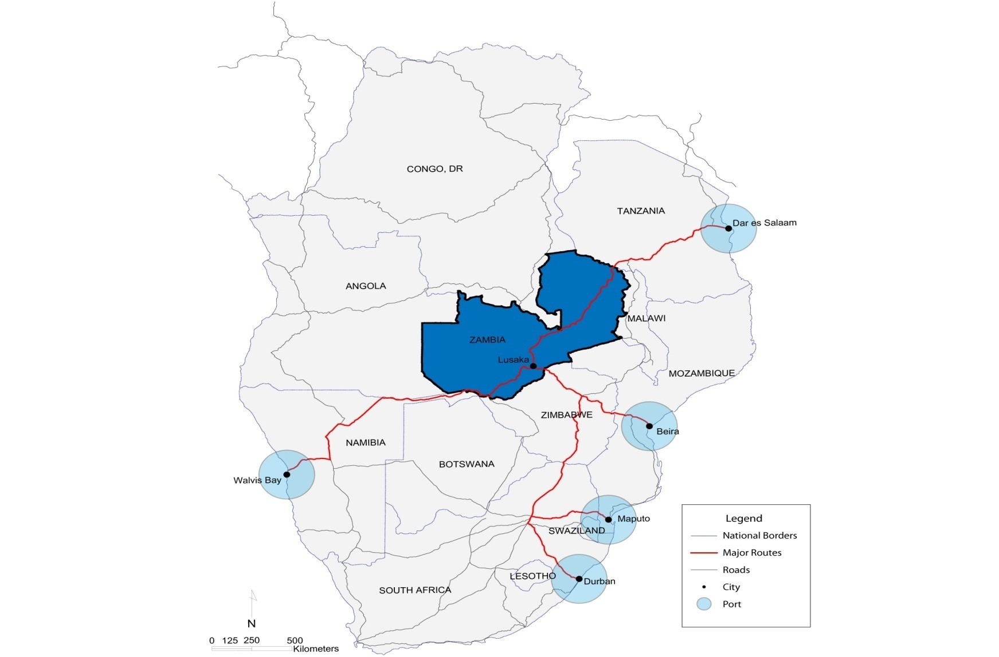
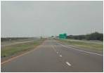
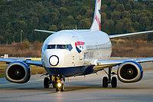

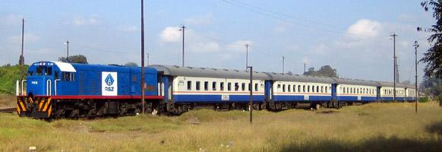
Strategically Located
Organized Regional Roads
Untapped growing regional market
By Road
KENYA
Three Intl. Airports
By Air
Inter-connected rail
By Rail
RSA

Slide 9
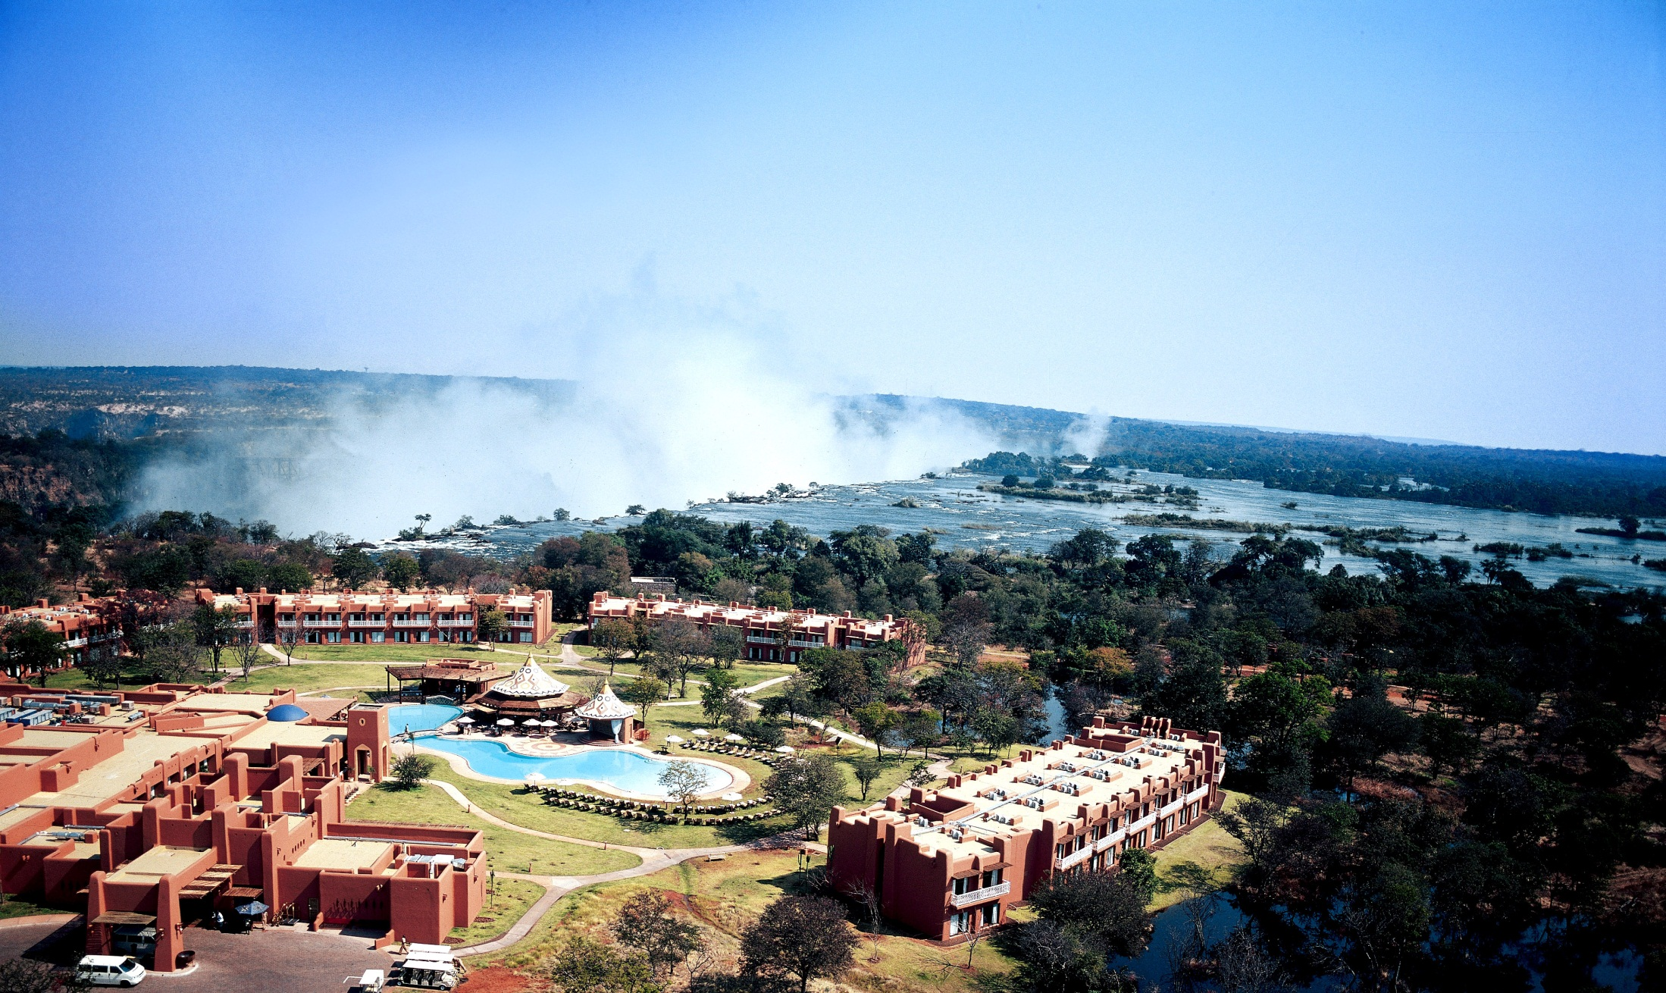
EXAMPLES OF SOME TOURISM INVESTMENTS
Sun International Resort and Convention Centre

Slide 10
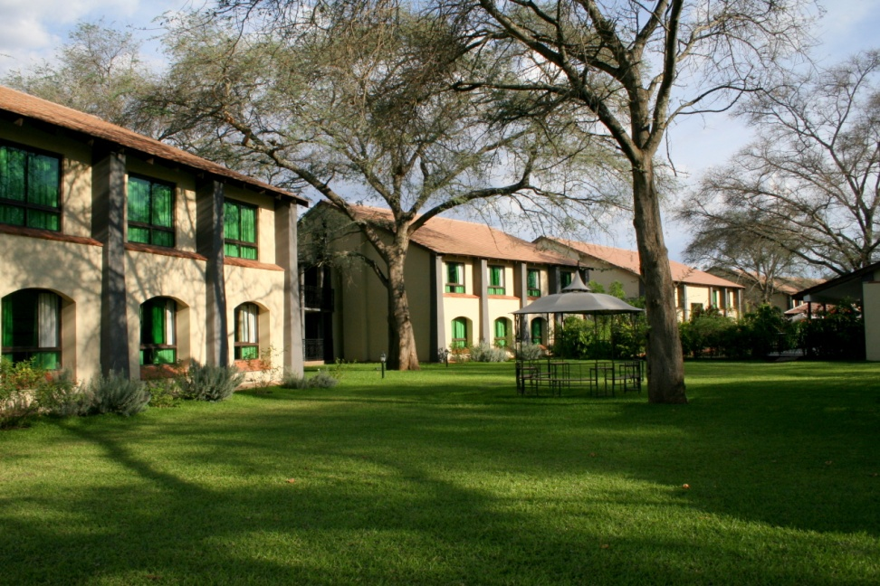
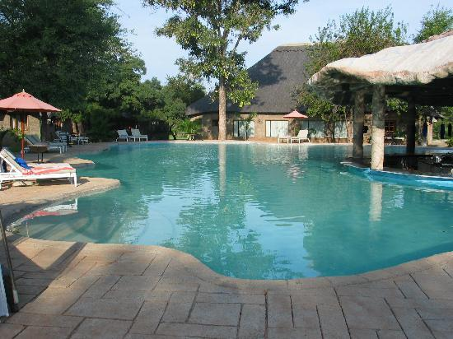
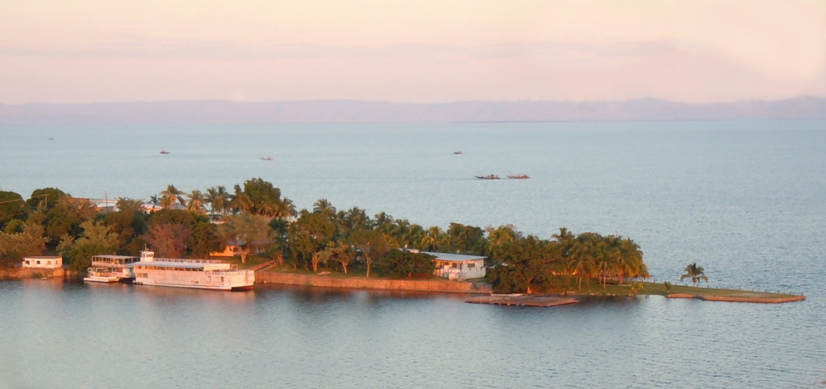
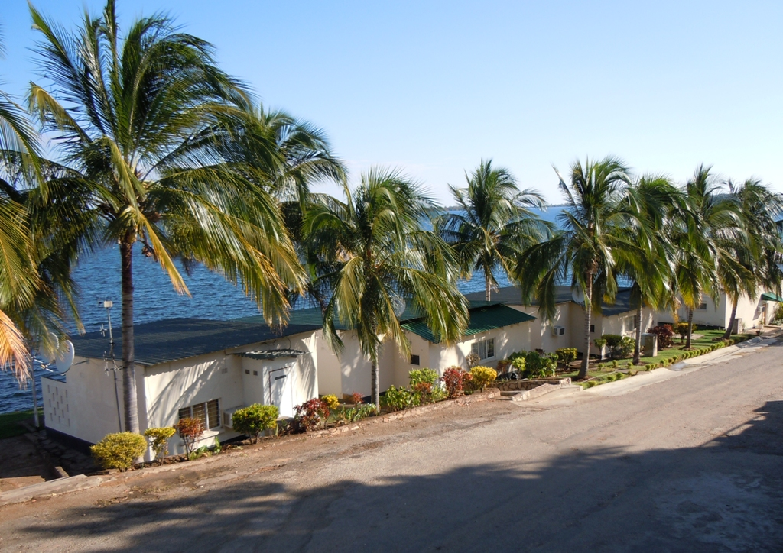
PROTEA HOTEL LIVINGSTONE
CHRISMA HOTEL LIVINGSTONE
LAKE SAFARI LODGE IN SIAVONGA

Slide 11
YOU ARE MOST WELCOME TO ZAMBIA
THANK YOU!

